Slide 1
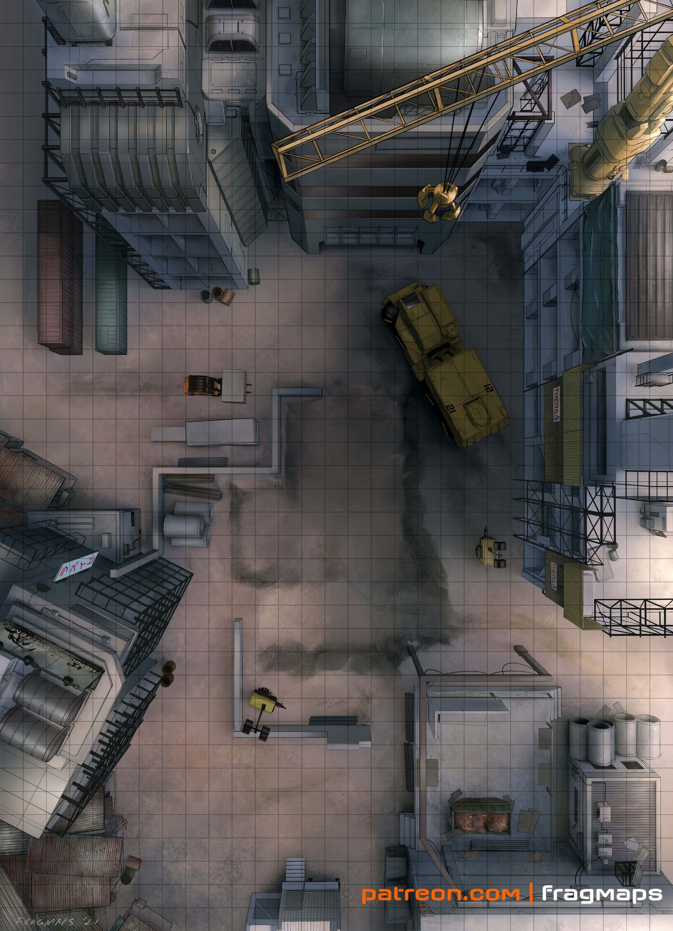
The Plot: A small village is being bulldozed by Aztechnology. The Job: Infiltrate the island and stall the demolition team. The Pay: 500¥ up front, 1% of all damage done, penalty for collateral damage, max 3k.
Scene 1 (Social). Setting: An abandoned warehouse in Auburn. The Hook: Runners were told by their fixers to meet here. Given dossiers with images, major skills, names of the rest of the team (have players introduce their characters). Events: Mr. Johnson presents the job and terms. Negotiation: per SMG p16, vs Influence 5 CHA 6, 5% increase/decrease in base pay per hit (max still 3k per SMG).
Scene 2 (Investigation). Setting: per players. Available Info:
Island 37 is in Outremer. It was recently sold by Mitsuhama to Aztecnology as part of a deal.
Island 37 was not an MCT "Zero Zone", but the area was restricted to MCT employees and their immediate families. They created a home for themselves on the island over the last decade.
Aztecnology is not interested in having MCT aligned persons on their island. While MCT employees were given meager relocation packages, their families were not.
There is one primary dock functioning on the island, but there are a few other beaches accessible via dinghy.
While Aztecnology isn't normally known for Matrix defense, much of the MCT infrastructure was repurposed. The island host is around Rating 7-9.
Aztecnology has deployed mundane and magical forces to manage the currently peaceful protests from the villagers.
An MCT director, Michiko Sakata, was the overseer on the island and was rumored to have her own family on the island. (She's the client for this run).
Optional Rules for Initiative. Purpose: Get all players involved in all scenes at First Taste. Social: Influence + CHA. # hits determines order. Ties: Edge, CHA, INT, Coin Flip. Investigation: Perception + INT. # hits determines order. Ties: Edge, INT, REA, Coin Flip.
Scene 3 (Investigation). Setting: Island 37. Edge: 1 per 2 successes in Scene 2 for each player (max 2). Challenges:
The players can arrive on the island with relevant skill checks. Guards at the dock are Patrolmen (stats: CRB 206). Routine shipments are scanned by a Doberman with a chemsniffer (rating 3, CRB 242).
The equipment is in use during the day, and at night are parked in a nearby construction site.
The area around the equipment is patrolled by fly spies, rating 1 watcher spirits, and occasionally two person patrols.
Players can use a variety of skills to destroy the equipment.
The crane is valued at 100,000¥.
The mobile office, including the rating 4 host in it, is worth 75,000¥.
The various portable lights and smaller construction drones are worth 25,000¥ total.
Another 25,000¥ can be destroyed by eliminating all the construction materials.
Scene 4 (Combat). Setting: The Construction Site. Edge: 1 per player if they get advanced notice, 1 more (max 2) if they set up an ambush. Challenges: 1 enemy per player (max 4). Choose from:
Patrolman (CRB 206)
Decker (CRB 205)
Combat Mage (CRB 206)
SWAT Officer (CRB 206)
Picking Up the Pieces. Pay: negotiated base pay plus bonus for destruction, penaltiy for collateral damage. Max 3k per player
Karma: 3 karma for adventure survival.
Contacts: Yuriko Star (Corporations – Renraku, Data Havens, Connections 2 Rating 1). A technomancer that Renraku held since birth and made believe she was an AI.
Return on Divestment
A Shadowrun 6e First Taste by Zeshan Rajput
https://creativecommons.org/licenses/by-sa/3.0/
CRB: Shadowrun 6th Edition Core Rule Book
SMG: Shadowrun Missions Guide v1.6
Map Credit: Fragmaps on Patreon

